Slide 1

CSE-752 – 03
Deep Neural Network
Lesson-1

Slide 2
Course Teacher: Khondaker Refai Arafat
M. Sc. in Computer and Systems Science (Stockholm University)
MBA (IBA-Dhaka University)
B.Sc. in Computer Science and Engineering (SUST, Sylhet)
Work in: Grameenphone, Ericsson, NOKIA, ZTE, Huawei, GE HealthCare

Slide 3
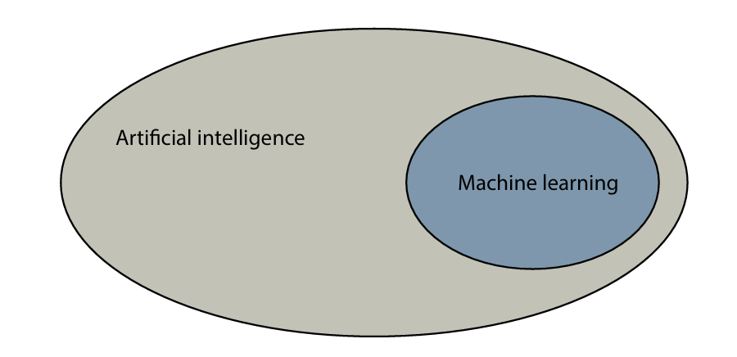
CSE-752 — Deep Neural Networks
Lecture 1: From Machine Learning to Neural Networks
ML fundamentals
Types of ML
Linear regression & classification
Perceptron → activation functions
Neural networks as collections of perceptrons
1

Slide 4
Tools and Python packages used in the course
NumPy — storing arrays and performing mathematical calculations
Pandas — storing, manipulating, and analyzing datasets
Matplotlib — plotting data
Scikit-Learn — training machine-learning models
Keras (TensorFlow) — training neural networks
Why these matter
They form a practical workflow: data → analysis → visualization → ML model → neural network.
2

Slide 5
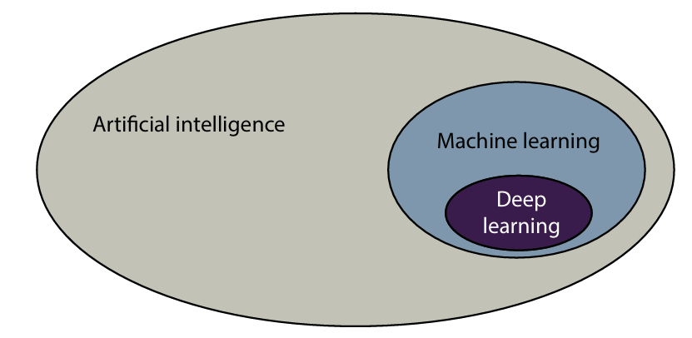
Machine Learning and Deep Learning
Machine learning is part of artificial intelligence.
Deep learning is a part of machine learning.
Deep learning uses neural networks.
Examples include image recognition, text generation, Go, and self-driving systems.
3

Slide 6
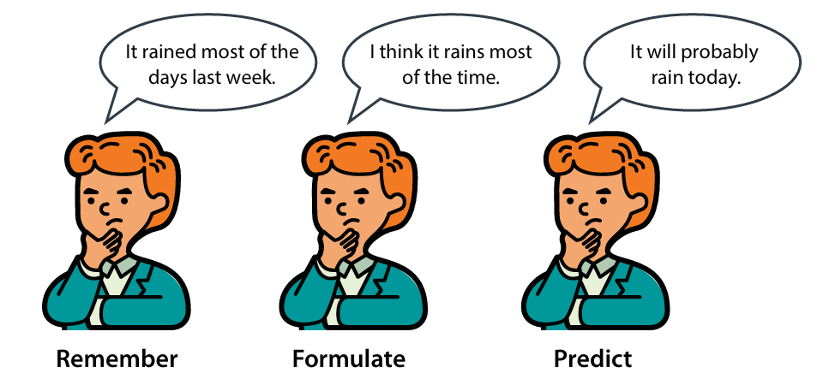
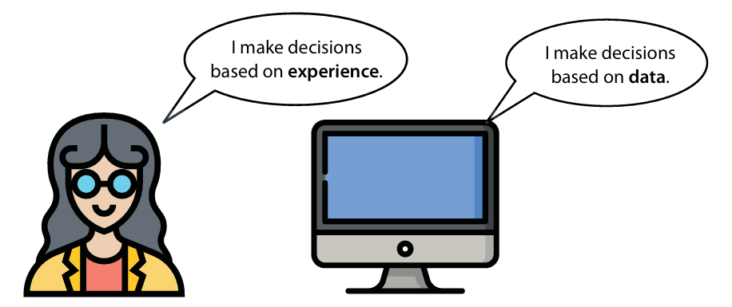
How do humans think — and how does ML learn?
Humans make decisions from previous experience.
ML systems make decisions from data.
A typical learning loop is: remember → formulate → predict.
4

Slide 7
Three essential ML terms
Data / Feature
Data is information. A feature is a property or characteristic that a model can use for prediction.
Model (Artifact)
A set of rules that represents data and can be used to make predictions.
Algorithm
A procedure or set of steps used to solve a problem or perform a computation.
5

Slide 8
Types of Machine Learning
Supervised learning — labeled data
Unsupervised learning — unlabeled data
Reinforcement learning — agent + environment + task
Semi-supervised learning is also commonly used when only part of the data is labeled.
Central question
What information is available to the learner, and how is learning feedback provided?
6

Slide 9
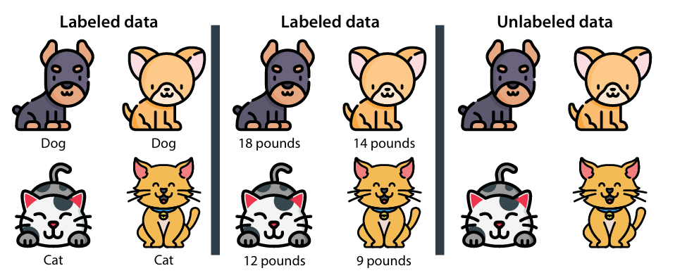
Data, labels, and predictions
Data is simply information.
Label = the target we want to predict.
Pet example: label can be cat/dog or sick/healthy.
A model's guess about a label is called a prediction.
7

Slide 10
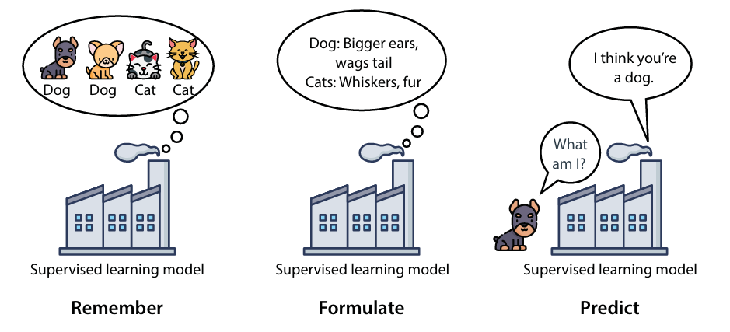
Supervised Learning
Training data contains features and known labels.
The model learns a rule from labeled examples.
For a new input, the model predicts its label.
Example: learn from dog/cat images, then classify a new image.
8

Slide 11
Numerical vs. categorical data
Numerical data
Uses numbers such as 4, 2.35, or −199. Examples: prices, sizes, weights.
Categorical data
Uses categories or states such as male/female or cat/dog/bird.
Regression
Predicts numerical data → output is a number.
Classification
Predicts categorical data → output is a category.
9

Slide 12
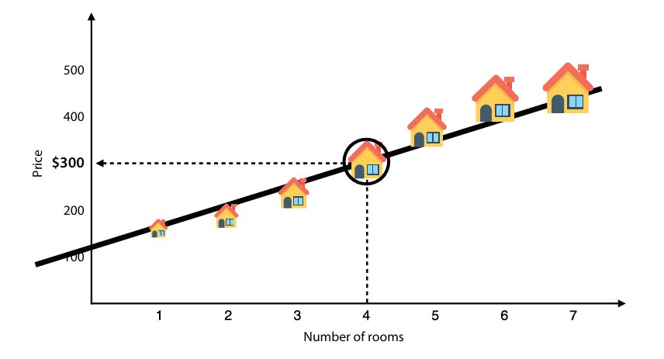
Supervised learning: regression and classification
Regression example: housing-price prediction.
Classification example: email spam detection.
Both learn from features to predict labels.
Key difference: number vs. category.
10

Slide 13
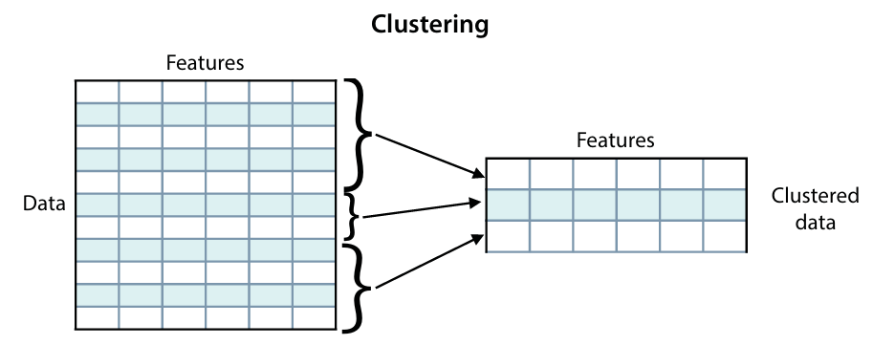
Unsupervised Learning
Data is unlabeled.
The goal is to extract useful information from the dataset.
There is no target label supplied for the model to predict.
Common tasks include discovering groups, simplifying data, and generating similar data.
11

Slide 14
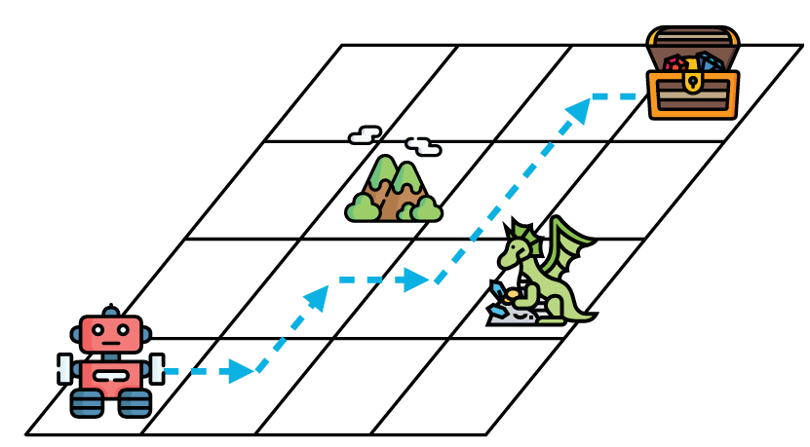
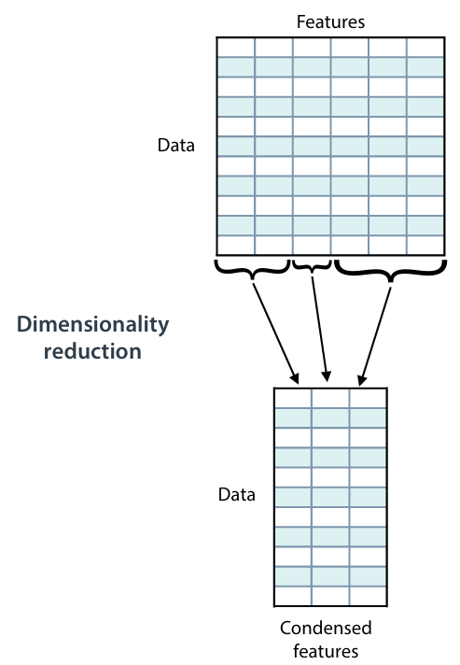
Three common unsupervised-learning tasks
Clustering
Group data into clusters based on similarity.
Dimensionality reduction
Simplify data and describe it with fewer features.
Generative algorithms
Generate new data points that resemble existing data.
12

Slide 15
Reinforcement Learning
The learner receives an environment rather than a conventional labeled dataset.
An agent performs actions in the environment.
Learning is driven by the task and feedback from interaction.
Think: navigate → act → receive feedback → improve behavior.
13

Slide 16
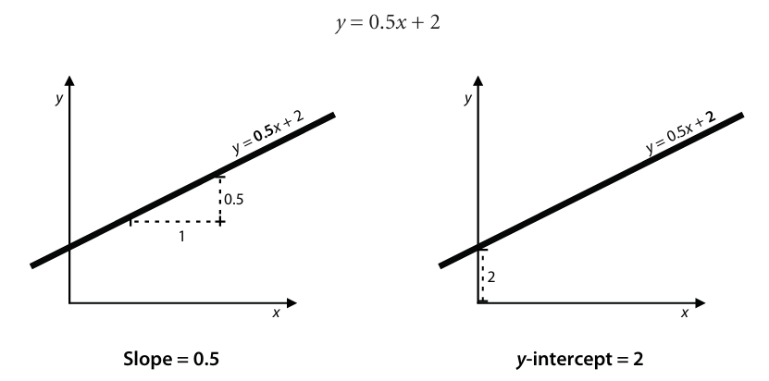
Linear Regression — the basic prediction model
A regression model predicts a number.
A line can summarize the relationship between a feature and the target.
The parameters of the line are learned from data.
14

Slide 17
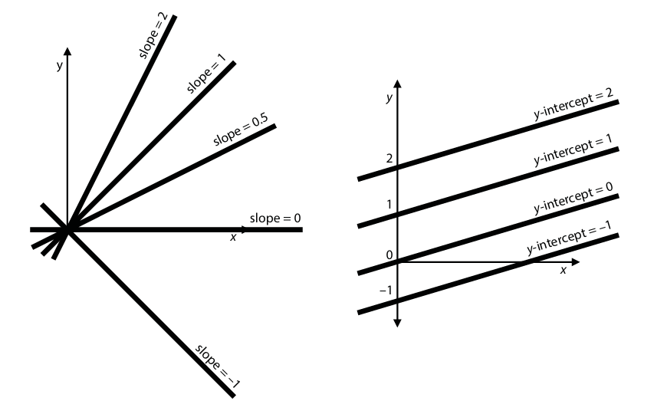
Weights and Bias
Each feature is multiplied by a corresponding factor: its weight.
The bias is a constant not attached to a feature.
Simple form: prediction = weighted features + bias.
Example from the source: room-count weight = 50; bias = 100.
15

Slide 18
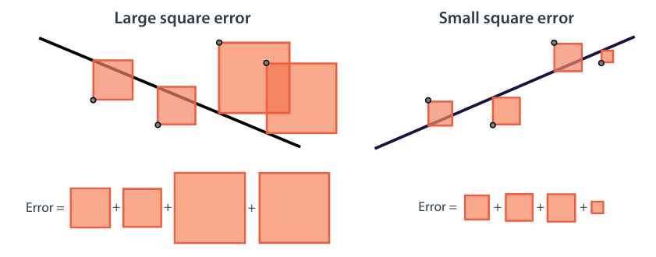
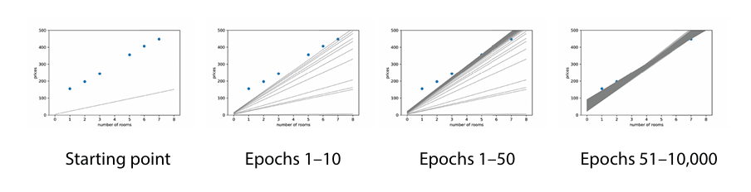
Regression line and model parameters
Changing the slope changes how strongly the feature affects the prediction.
Changing the intercept/bias shifts the line.
Learning a regression model means finding parameters that reduce prediction error.
16

Slide 19
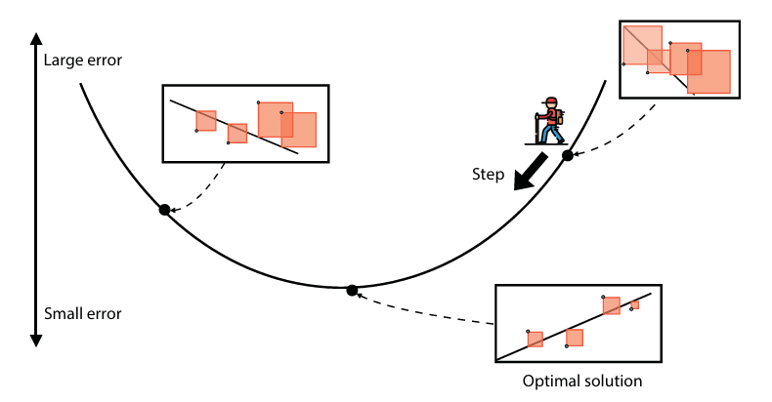

Gradient Descent — moving toward lower error
Each point on the error surface represents a different model.
Good models have small error; bad models have large error.
Gradient descent takes small steps in a direction that decreases error.
17

Slide 20
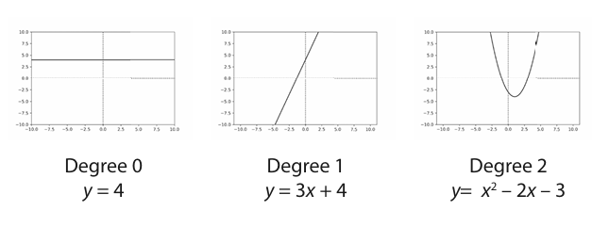
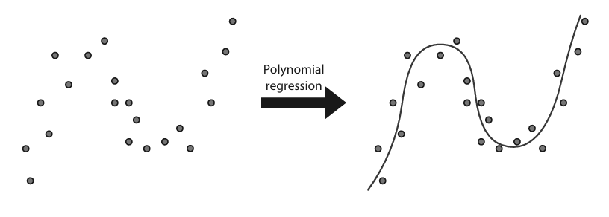
Polynomial Regression — increasing model flexibility
Polynomials can model relationships that a straight line cannot.
Higher degree increases flexibility.
Too much flexibility can lead to poor generalization.
18

Slide 21
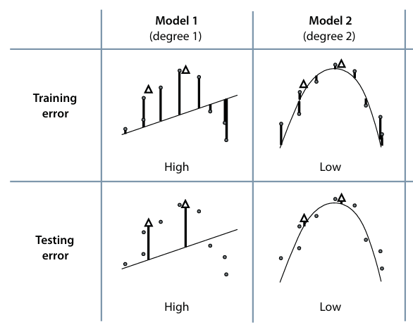
Training, Validation, and Testing Sets
Training set — used to train the models.
Validation set — used for decisions about which model to use.
Testing set — used to check how well the final model did.
Common splits in the source: 60–20–20 or 80–10–10.
19

Slide 22
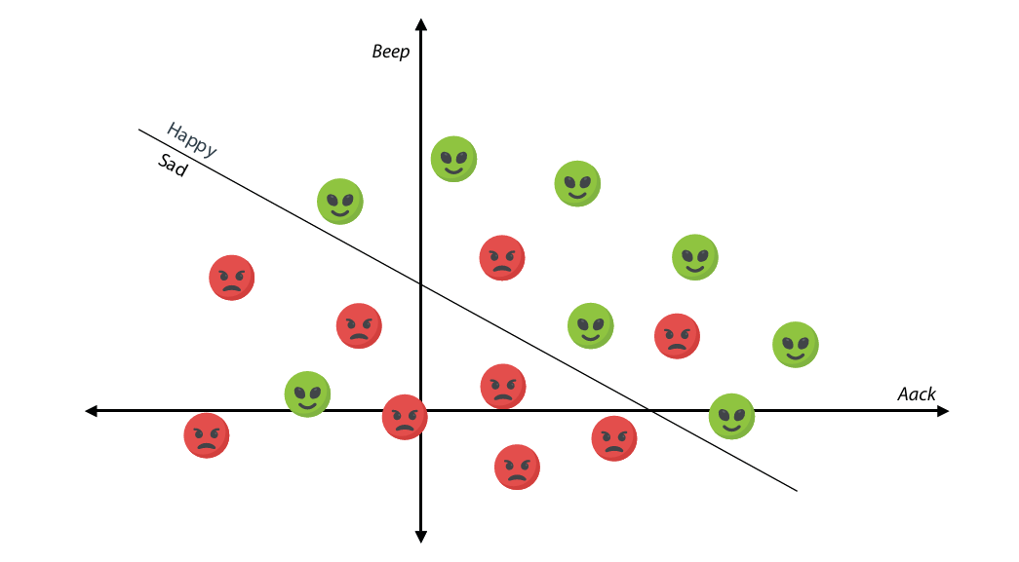
Classification and classifiers
Classification predicts a state or category rather than a number.
Classification models are called classifiers.
Many classifiers predict two states, often yes/no.
Example: sick vs. healthy; spam vs. not spam.
20

Slide 23
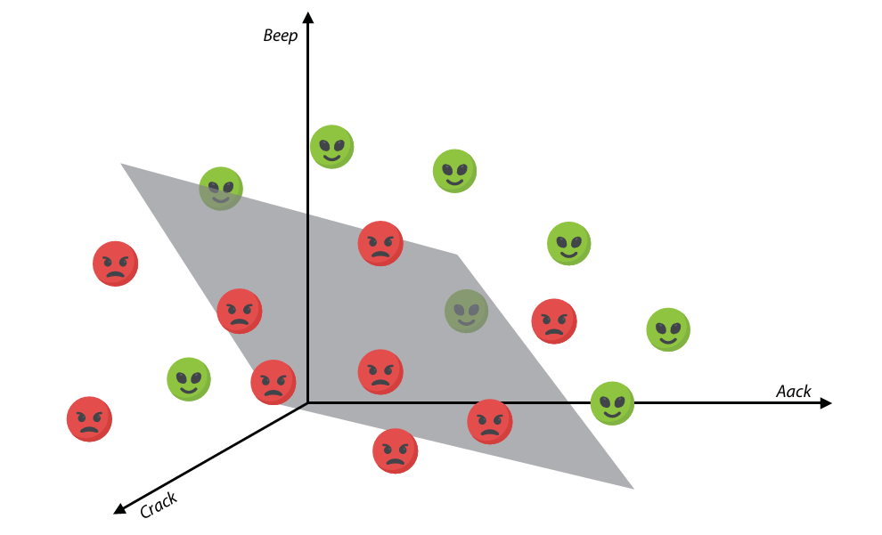
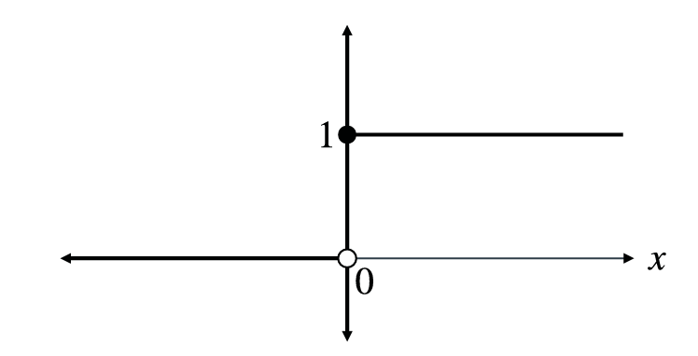
Perceptron — the bridge to neural networks
A perceptron produces a classification from weighted inputs.
A decision boundary separates two regions.
The perceptron can be improved repeatedly using a training procedure.
21

Slide 24
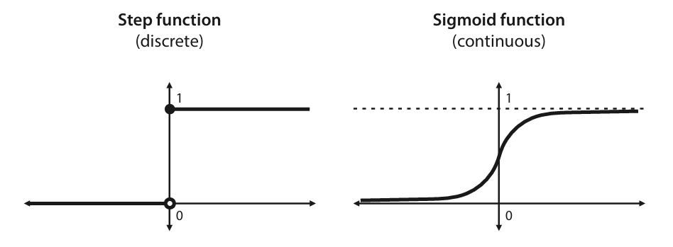
Step Function — turning a score into a prediction
Encode labels numerically: e.g., happy = 1, sad = 0.
step(x) = 1 if x ≥ 0; step(x) = 0 if x < 0.
The step function is a specific case of an activation function.
22

Slide 25
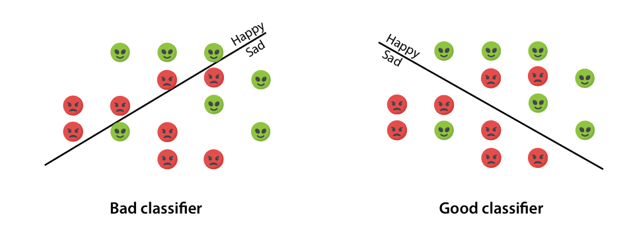
Decision boundary and hyperplane
In 2D, a line can separate two classes.
In 3D, a plane can separate two classes.
In n dimensions, the analogous separator is an (n−1)-dimensional hyperplane.
23

Slide 26
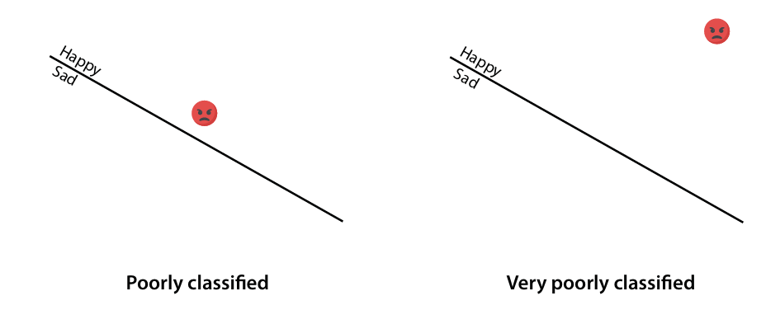
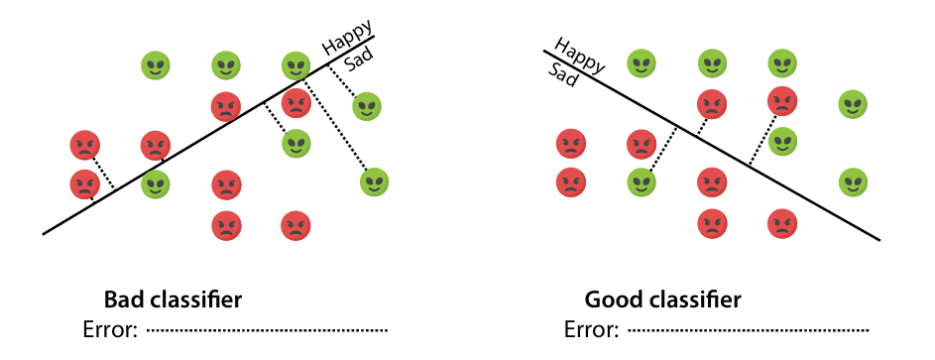
Weights and bias in a medical classification example
Medical example: predict whether a patient is sick or healthy.
Use labels y, features xᵢ, weights wᵢ, and bias b.
The bias can be interpreted as the score of the empty input.
24

Slide 27
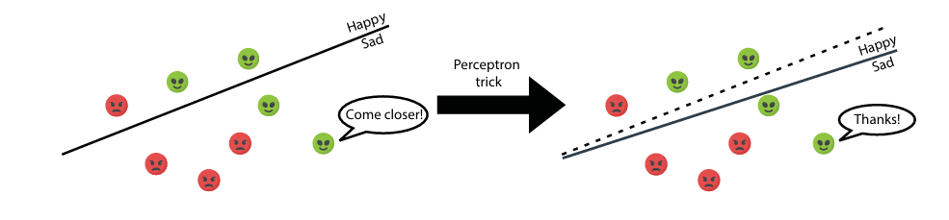
How to compare classifiers — the error function
An error function assigns a numerical measure to how bad a classifier is.
For the perceptron discussion, total error is based on errors from misclassified points.
A lower error gives a direction for improving the model.
25

Slide 28
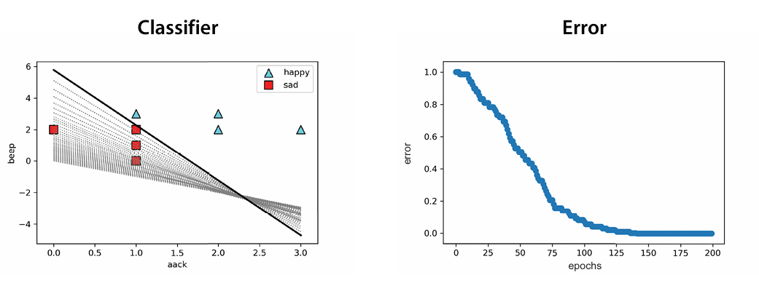
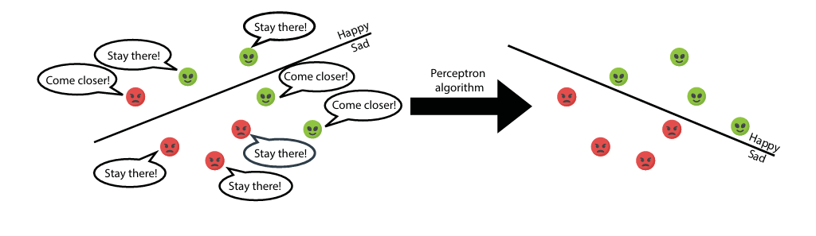
Gradient descent for minimizing classifier error
Reduce error in small steps rather than trying to jump directly to the best model.
The error surface provides the direction of improvement.
The same optimization idea will reappear in neural-network training.
26

Slide 29
Perceptron Algorithm — repeated improvement
Start with a classifier.
Use the perceptron trick to improve predictions on data points.
Repeat the process many times.
Epochs = number of times the algorithm is run.
Learning rate controls the step size.
These are hyperparameters of the algorithm.
Pseudocode
Inputs:
• Dataset of points labeled 1 and 0
• Number of epochs, n
• Learning rate, h
Repeat for each epoch:
improve the classifier using the training points
27

Slide 30

Sigmoid Function — a continuous activation
The sigmoid takes a score and outputs a value between 0 and 1.
Positive scores map closer to 1; negative scores map closer to 0.
At score 0, the output is 0.5.
Continuous predictions provide more information than a discrete step.
28

Slide 31
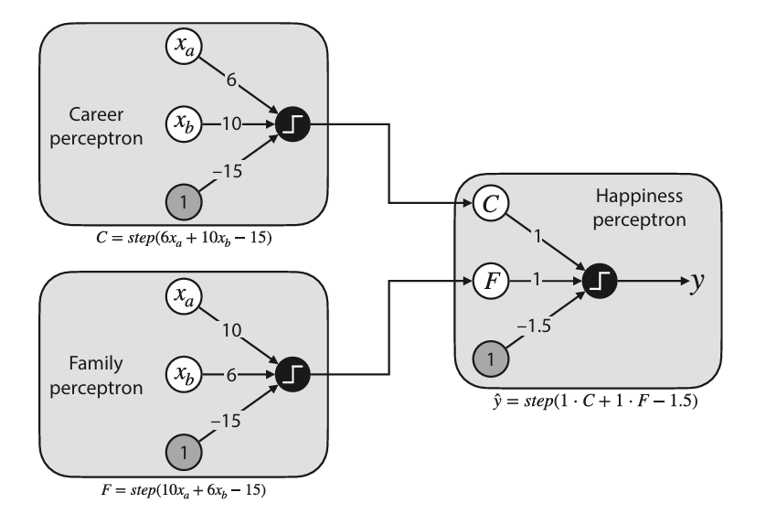
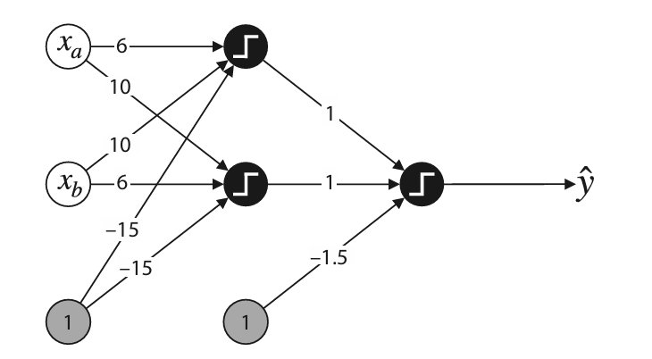
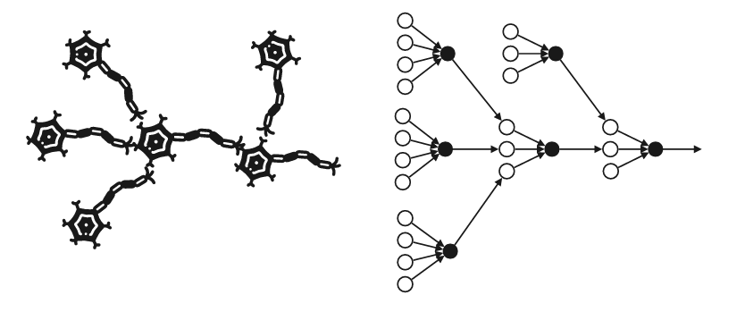
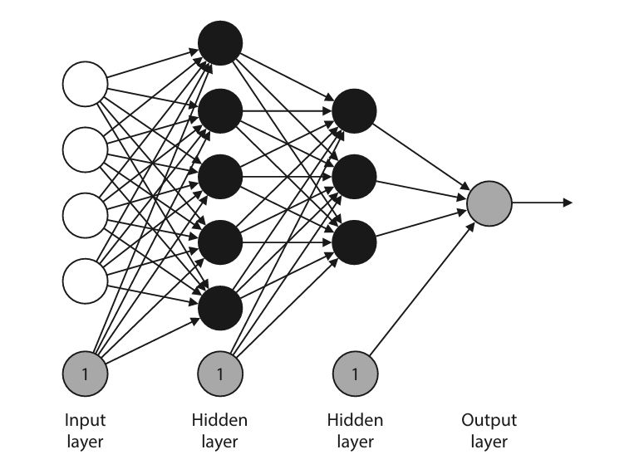
Neural Networks — from perceptrons to Deep Learning
One way to understand a neural network is as a collection of perceptrons.
Networks contain nodes, edges, layers, weights, bias, and activation functions.
Neural networks support both classification and regression.
Deep learning uses neural networks in applications such as vision, language, medicine, and autonomous systems.
29

Slide 32
Thank You

